Slide 1
Brain Tumor Diagnosis via Artificial Intelligence
By Andrew McLaughlin

Slide 2
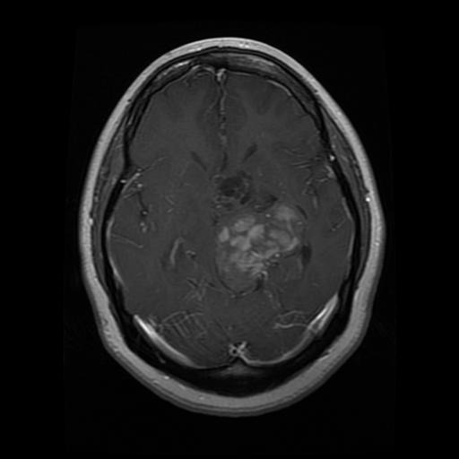
Can AI Assist in Diagnosis of Brian Tumor
Yes, correctly implemented, an artificial neural network can be used to diagnose brain tumors with 99% accuracy.

Slide 3
Speedy Diagnosis is Critical
Fast and accurate diagnosis is key to early intervention which improves outcomes with regards to brain cancer.
Reduce the risk of brain injuries caused by the presence of the tumor.

Slide 4
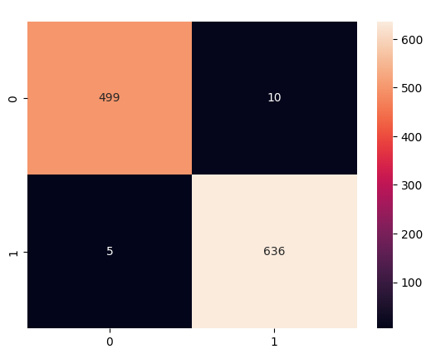
Creation of a Neural Network
Using a convolutional neural network of 9 layers a diagnostic tool can be created with 99% accuracy and 99% recall.

Slide 5
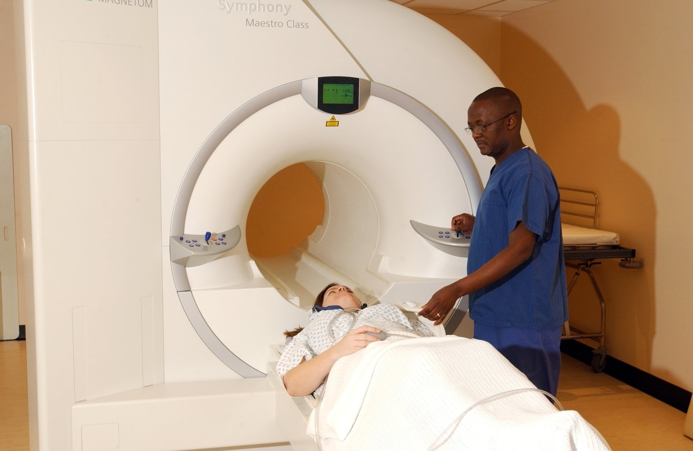
Is There Room For Improvement
With more data and more computing power an even more accurate model can be made, it would be especially useful for the model to be able to distinguish between different types of brain tumors.

Slide 6
Citation
https://www.ncbi.nlm.nih.gov/pmc/articles/PMC6136128/
https://www.cancer.gov/news-events/cancer-currents-blog/2020/artificial-intelligence-brain-tumor-diagnosis-surgery#:~:text=Testing%20in%20a%20Clinical%20Trial&text=That%20proved%20to%20be%20the,overall%20accuracy%20rate%20of%2093.9%25.

